Slide 1
CS 504
by Boris Valerstein

Slide 2
Object Creation
Let’s create a Pizza!
A pizza can have many toppings
For the sake of example, let’s say:
Cheese (optional)
Mushroom (optional)
Pepperoni (optional)
Needs a size (required)
Use your imagination
Many more toppings

Slide 3
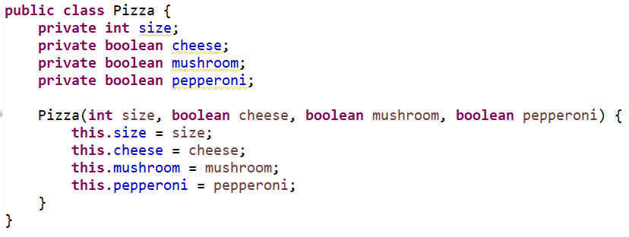

Pizza!
Creation pain:
Remember: imagination

Slide 4
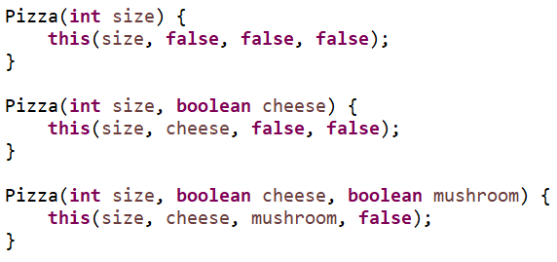
Constructor Overloading
What about cheese and pepperoni?
But no mushrooms
How many constructors will we need?
What if param order changes?

Slide 5
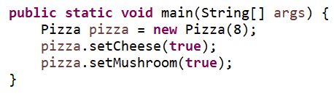
Using Setters
How many setters will I need?
I forgot something
Pepperoni!
Likely to cause null pointer somewhere
Or default it, but then unintentional setting
Partial construction – invalid state
Not immutable

Slide 6
Immutability
Definition: “not capable of or susceptible to change”
Can’t be changed
Computer Science:
No changes after construction
No setters
No means of changing internal state

Slide 7
The Builder Pattern
Creational design pattern
Create complex objects
Can be configured for immutability
But doesn’t have to be

Slide 8
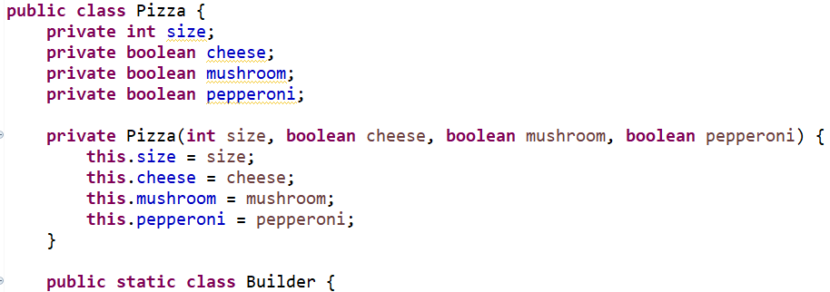
Step 1
Private constructor (only one)
Enforce construction, like singleton
Create internal class Builder

Slide 9
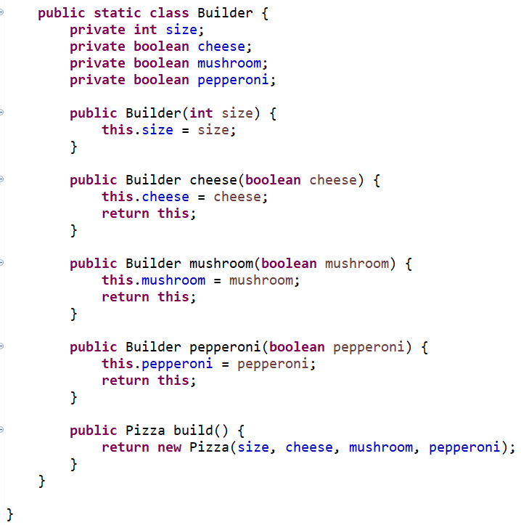
Step 2

Slide 10
Important
Builder constructor
All required attributes
One method for each optional attribute
Each returns the Builder, not a Pizza
One build() method
Returns the Pizza

Slide 11
Step 3: Profit
Only size is required
Everything else is optionally built
Once build() is called, pizza is complete
Clean code?

Slide 12

Better
There’s a better, cleaner way
First, simplify Pizza constructor
Only required fields
Add Pizza instance to the builder
build() returns the instance of Pizza
Set the fields of the Pizza in each method

Slide 13
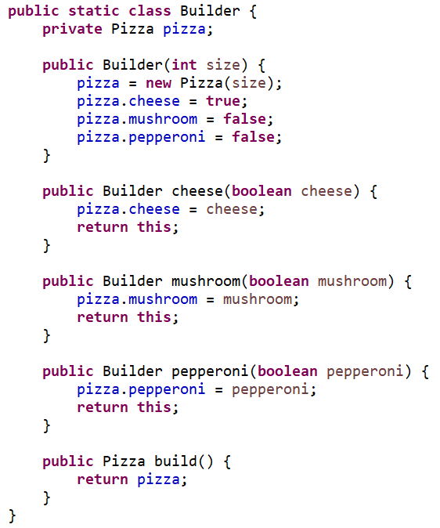
Better (code)

Slide 14
Clean Code!
No duplication
Minimal singular constructor
Private, to enforce Builder pattern
Builder is an internal class
Thus has access to Pizza fields
Even though they are private
Default values are set with ease
Pizza fields may not stay private
Default visibility is common (constraints)

Slide 15
Builder Benefits
Object can only be created via Builder
All required attributes are required
Optional attributes can be added
String them together in any order
No maintenance nightmare
Add/remove fields with ease
Exception handling
Builder, Single Responsibility Principle
Optional unset fields or invalid entries

Slide 16
Validation
Checking entries is important
Must check after object creation
Not the builder’s attributes
Option 1:
Throw error in each builder method
Option 2:
Throw error in the build method
Option 3:
Throw error in the constructor

Slide 17
Option 1
Throw error in each builder method
Intrinsically invalid values
Size -1
CarBuilder fields:
boolean sportsCar
int seats
Rule: Invalid if sportsCar has 4 seats
Can’t be checked at the method level

Slide 18
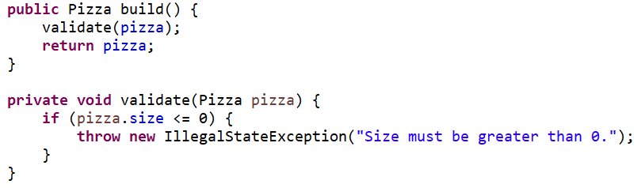
Option 2
Throw error in the build method
Implies responsibility of Builder
Validation

Slide 19
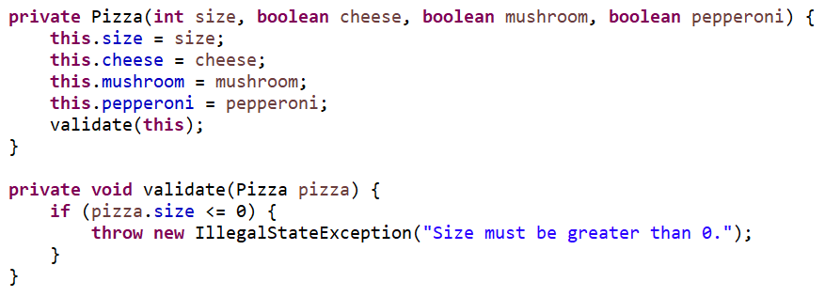
Option 3
Throw error in the constructor
Follows SRP better
But creates very unclean code

Slide 20
SRP vs Clean Code
This isn’t Batman vs Superman
The spirit of both:
Decrease maintenance costs
Option 3 has higher maintenance costs
Long gross constructor
Multiple constructors
Field duplication in the Builder
Option 2 is the winner
SRP is only kinda violated

Slide 21
Assignment
KWIC – Goodbye
Now we build up
Contrived software system
To demonstrate useful design patterns
Use Builder to create 2 types of objects
Instructions in the assignment

